Slide 2
Mission
Hillsborough County Public School’s Dual Language Immersion Program in partnership with students, parents, and the community, will establish a strong, standards-based curriculum, which promotes high academic achievement in both Spanish and English. It will cultivate global competence and an appreciation for a multicultural society.
Vision
Preparing bilingual, biliterate, and bicultural students for life.

Slide 3
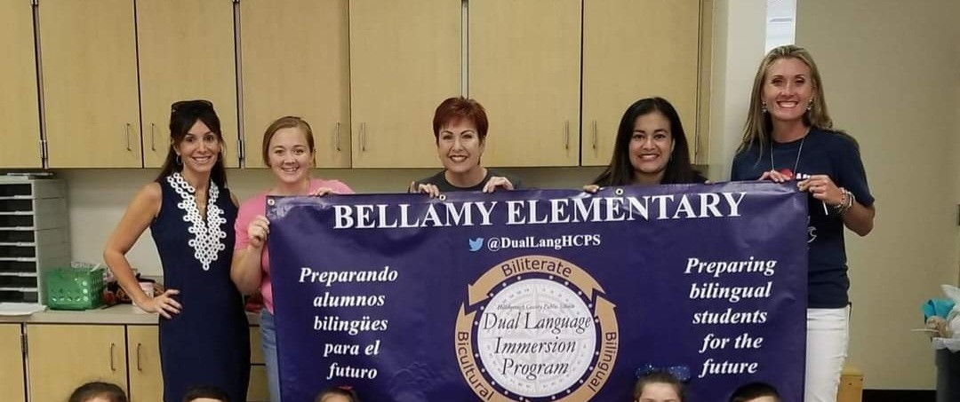
Where We Began.
2017 Dual Institute
Bellamy- Kindergarten
Crestwood- Kindergarten
80 Students
4 Teachers

Slide 4
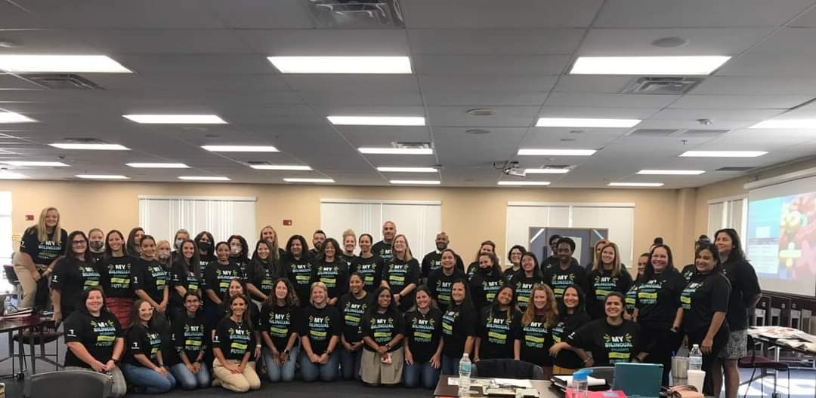
2023-2024
1,900+/- students
75+ Teachers
Elementary
Bellamy VPK-5
Cannella K-3
Crestwood VPK-5
Dawson K-1
Deer Park K-3
Lanier K
Reddick K-5
Ruskin K-3
Summerfield Crossing K-1
Westchase K-5
West Shore K
Woodbridge K-1
2021 Dual Institute
Middle School
Pierce
Smith
Shields

Slide 5
How do students benefit in a Dual Language Program?
Prepares them for college and career readiness.
Develops higher-order thinking skills as they learn a 2nd language.
Provides cognitive advantages with the development of bilingualism & biliteracy.
Increases their reading proficiency in both Spanish & English.

Slide 6
Goals of the Dual Language Program
To maximize overall academic achievement by strengthening
oral, written & reading proficiency in both languages.
To prepare bilingual, bi-literate & bi-cultural students.
To close the achievement gap of our EL students.
To provide program students with a competitive edge in their future college, career and workforce plans .

Slide 7
2nd Language Acquisition
Language is acquired in a sequential & spiral form. The earlier a student is taught a 2nd language the greater possibility for bilingualism.
Research shows that it takes from 5-7 years to acquire academic language. It’s increasingly challenging to reach bilingualism if instruction is delayed until high school.
The content knowledge & skills acquired in one language are seamlessly transferred to the other language. (cross- transfer)

Slide 8
Dual Language Model In Hillsborough
50/50 enrollment model for all schools
Standardized instruction throughout the program
Standards based

Slide 9
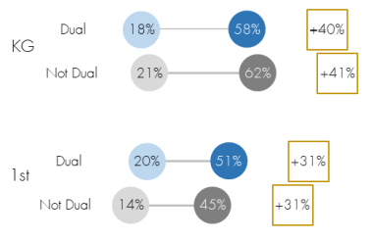
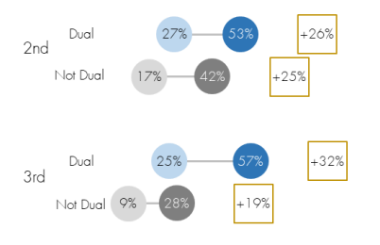
Academic Benefits
IReady Reading Fall- Spring

Slide 10
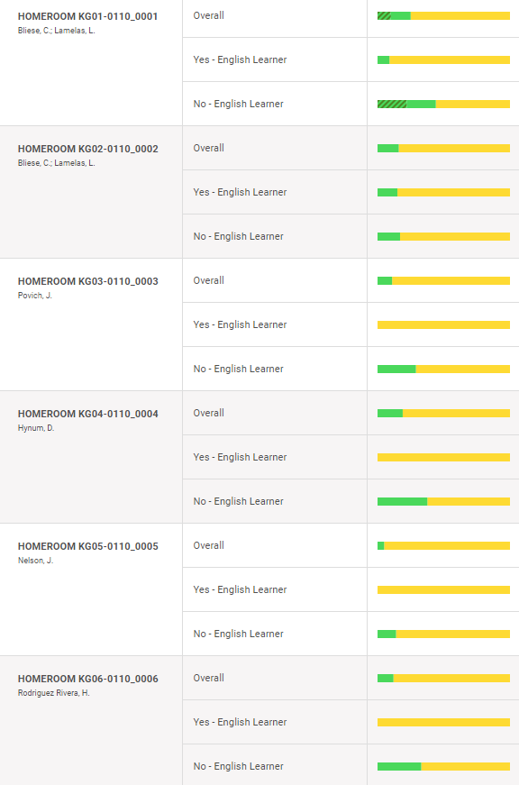
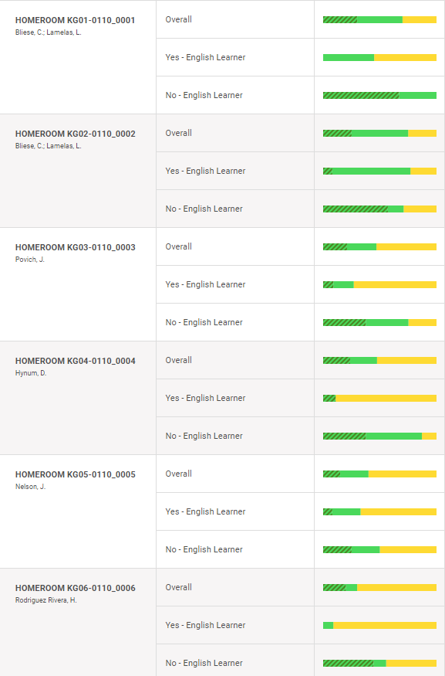
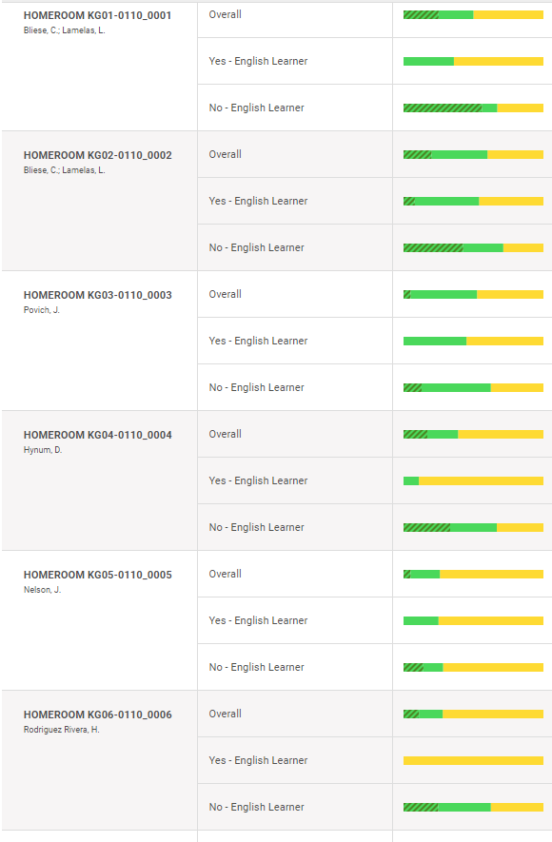
Winter
Fall
Winter
Fall
Spring
Spring
Dual
Dual
IReady
2022-2023

Slide 11
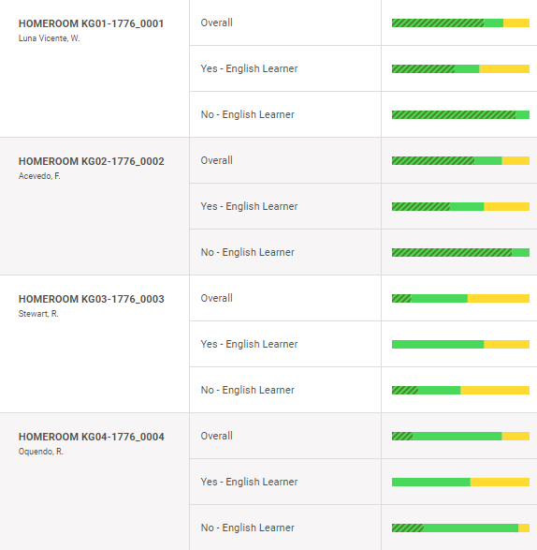
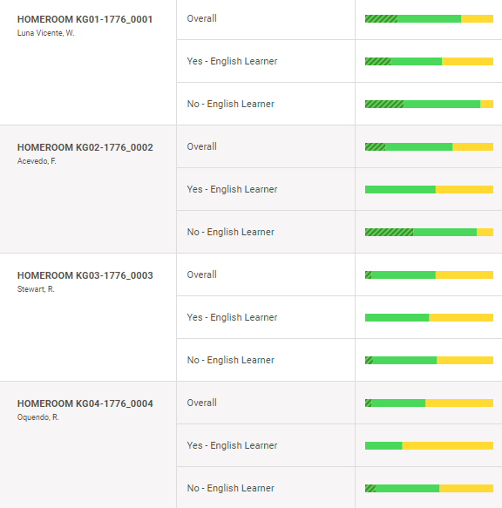
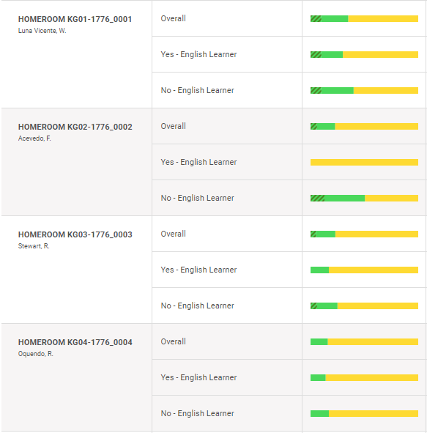
Fall
Winter
Spring
Dual
Dual
IReady
2022-2023

Slide 12
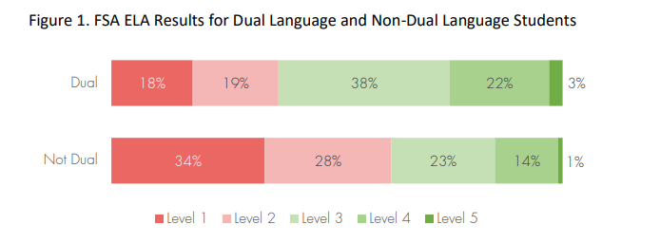
FSA Reading 2020-2021

Slide 13
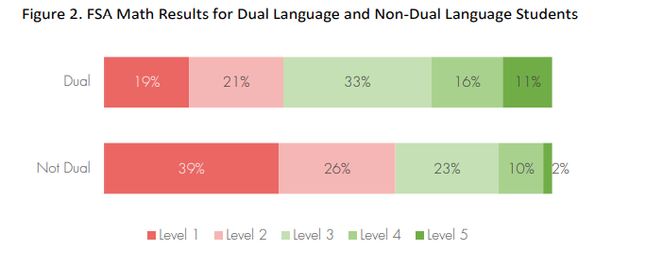
FSA Math 2020-2021

